Slide 1
Module3_Alpha_Beta_Pruning
Reference: Russell, S. and Norvig, P. Artificial Intelligence - A Modern Approach, 4th edition, Prentice Hall, 2020-Chapter 5, section 5.1 and 5.2

Slide 2
Alpha–Beta Pruning
The number of game states is exponential in the depth of the tree.
No algorithm can completely eliminate the exponent, but we can sometimes cut it in half, computing the correct minimax decision without examining every state by pruning large parts of the tree that make no difference to the outcome.
This particular technique is called alpha–beta pruning.

Slide 3
Alpha–Beta Pruning
Consider the two-ply game tree from Figure 5.2 .
The calculation of the optimal decision this time pays careful attention to what we know at each point in the process.
The steps are explained in Figure 5.5 (next slide).
The outcome is that we can identify the minimax decision without ever evaluating two of the leaf nodes.

Slide 4
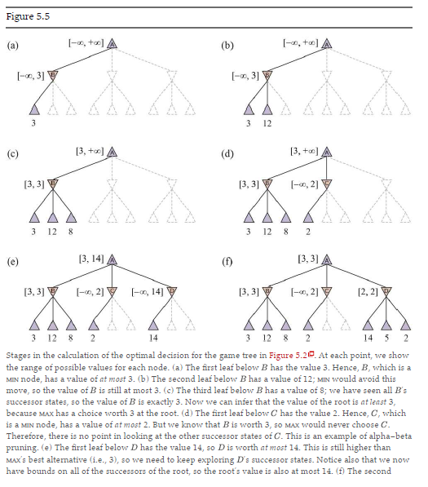
Example

Slide 5
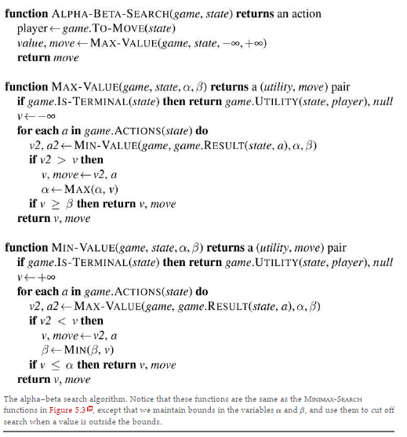
Alpha–Beta Search Algorithm
Figure 5.7

Slide 6
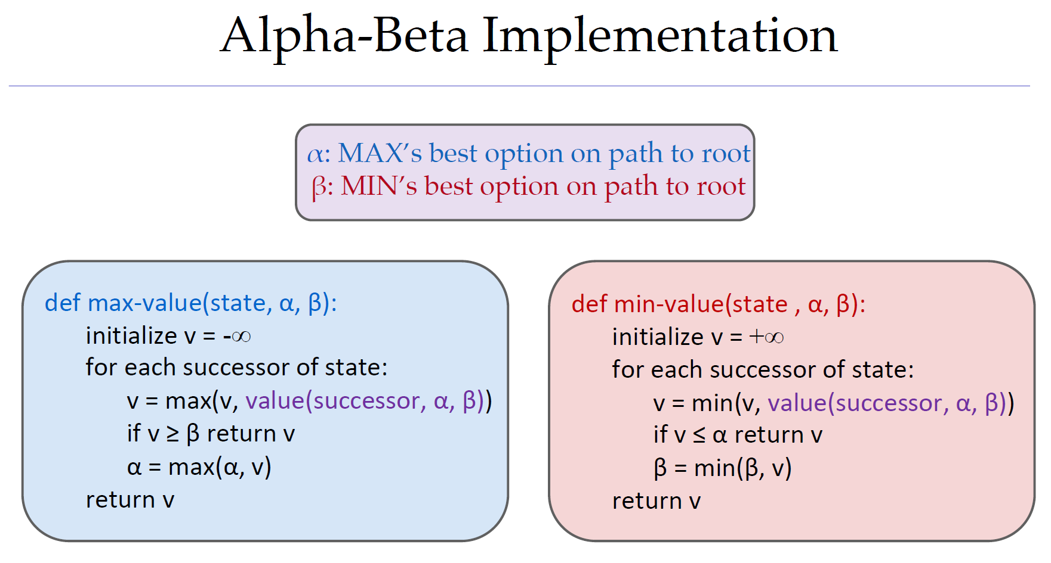

Slide 7
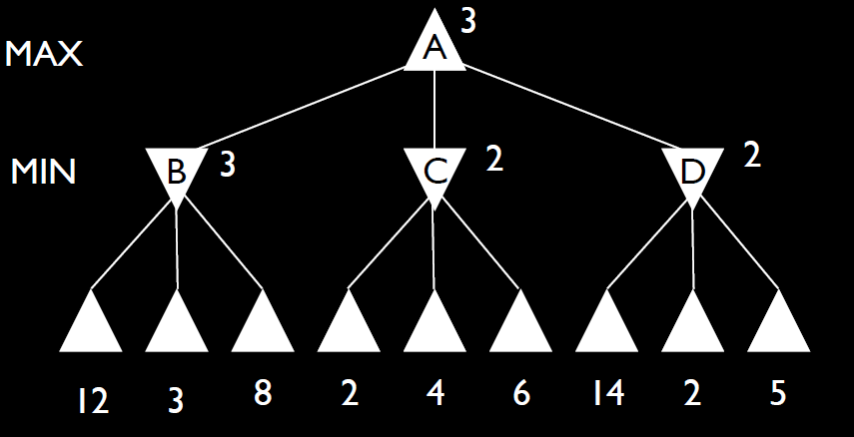
Example

Slide 8
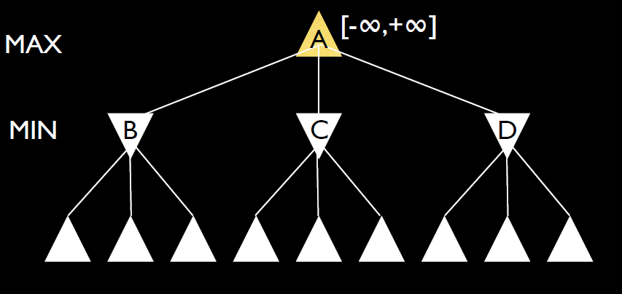
Example continued

Slide 9
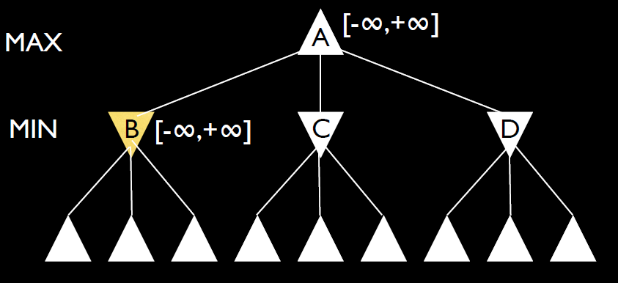
Example continued

Slide 10
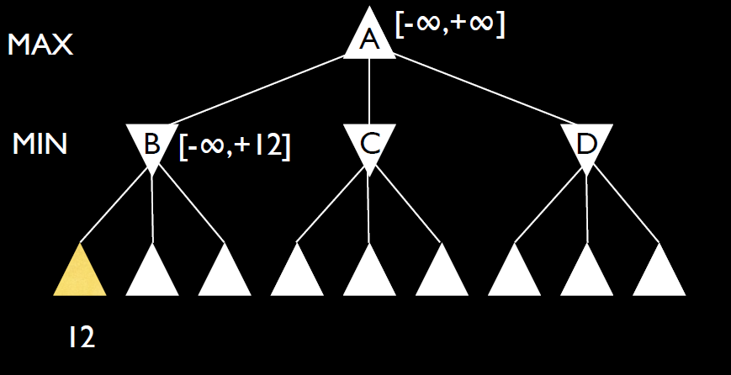
Example continued

Slide 11
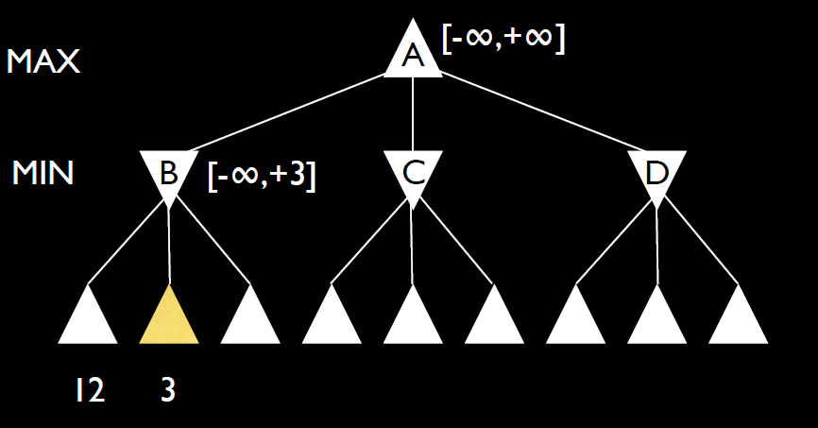
Example continued

Slide 12
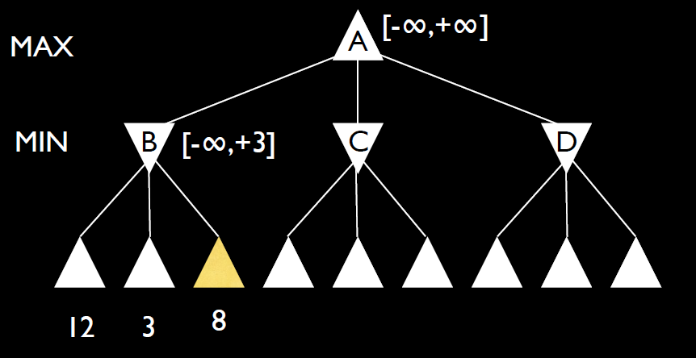
Example continued

Slide 13
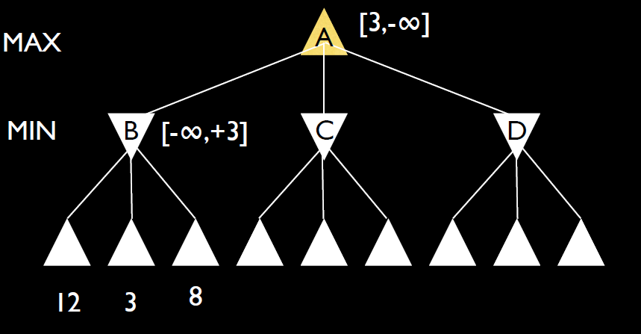
Example continued

Slide 14
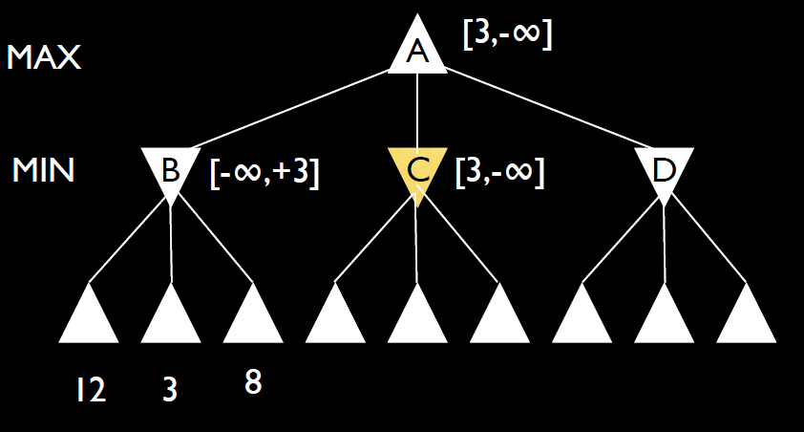
Example continued

Slide 15
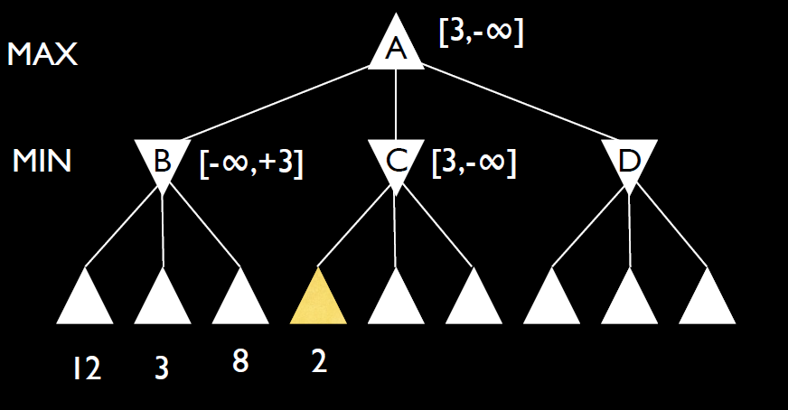
Example continued

Slide 16
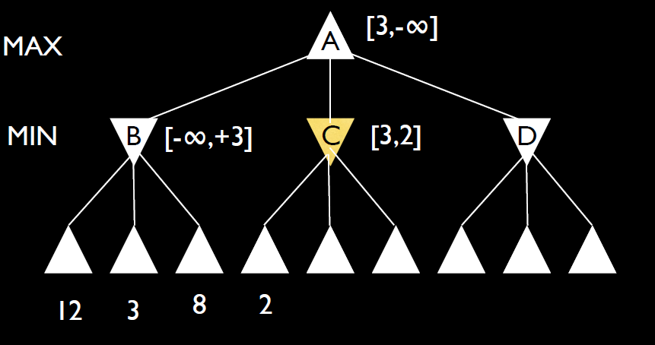
Example continued

Slide 17
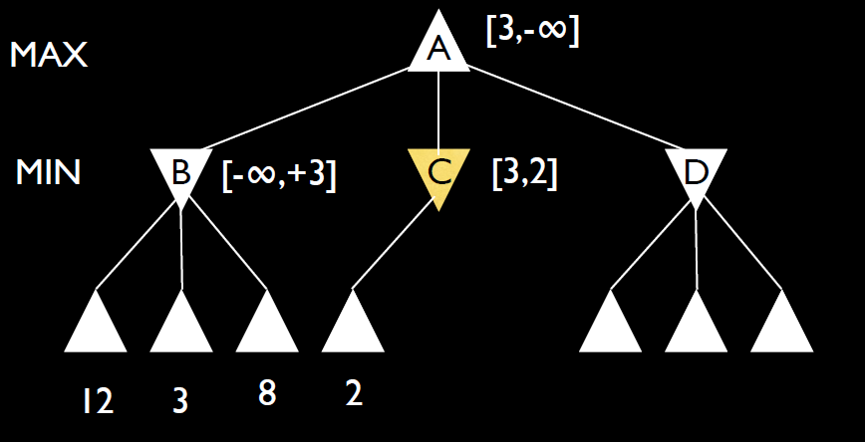
Example continued

Slide 18
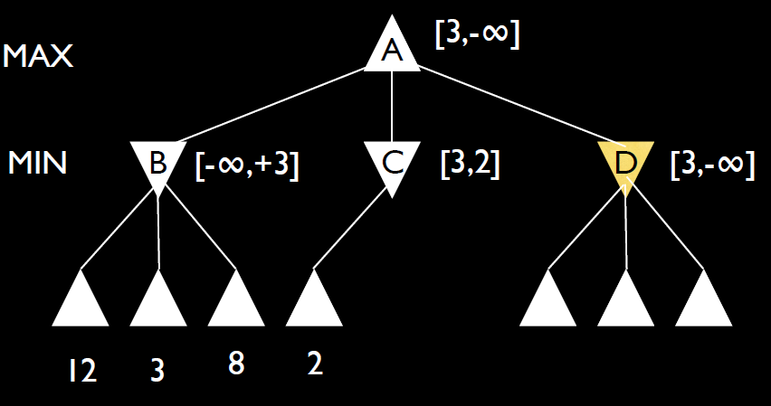
Example continued

Slide 19
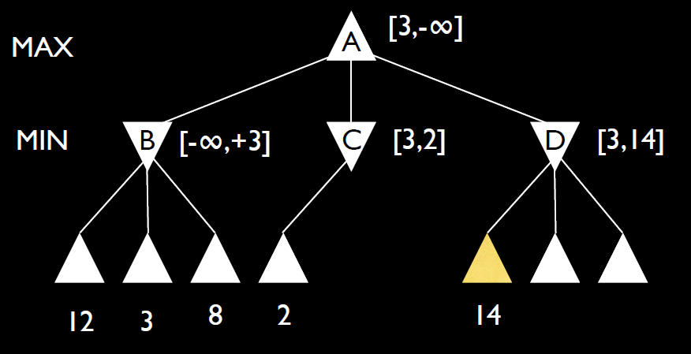
Example continued

Slide 20

Example continued

Slide 21
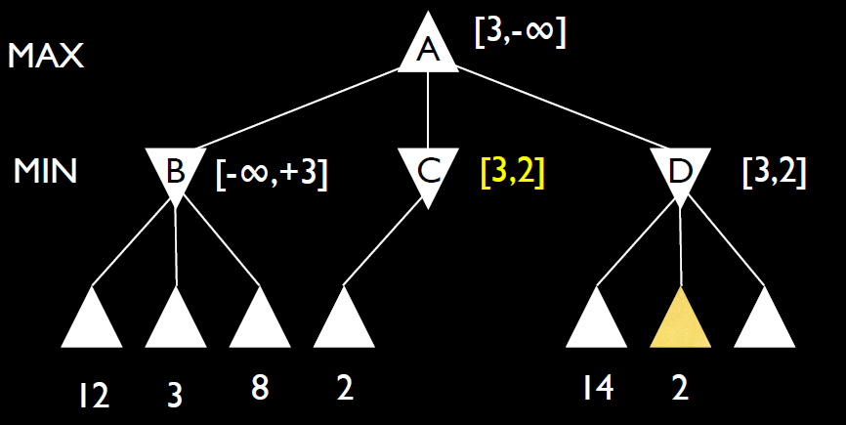
Example continued

Slide 22
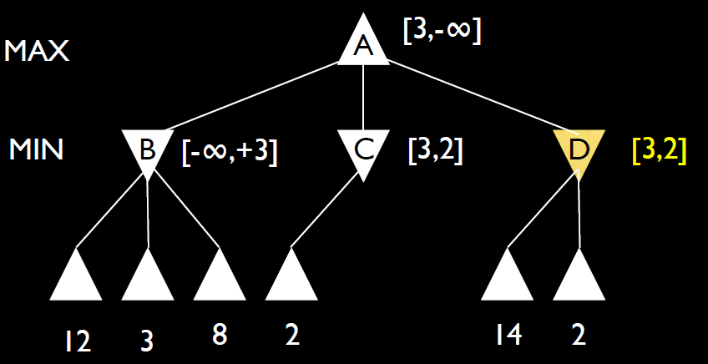
Example continued

Slide 23
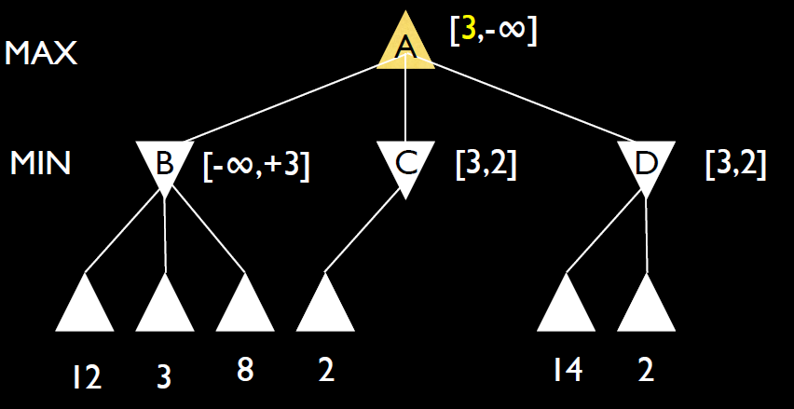
Example continued

Slide 24
